Slide 1
Introduction to Multidimensional Data Model

Slide 2
Online Transaction Processing (OLTP) Systems

Slide 3
OLTP
The full form of OLTP is Online Transaction Processing.
OLTP is an operational system that supports transaction-oriented applications.
It administers the day-to-day transaction of an organization.

Slide 4
OLTP
OLTP or Online Transaction Processing is a type of data processing that consists of executing a number of transactions occurring concurrently—online banking, shopping, order entry, or sending text messages, for example.
These transactions traditionally are referred to as economic or financial transactions, recorded and secured so that an enterprise can access the information anytime for accounting or reporting purposes.

Slide 5
OLTP
It also includes any kind of interaction or action such as downloading pdfs on a web page, viewing a specific video, or automatic maintenance triggers or comments on social channels that maybe critical for a business to record to serve their customers better.

Slide 6
Transactions
The primary definition for transactions— economic or financial—remains the foundation for most OLTP systems.
So, online transaction processing typically involves inserting, updating, and/or deleting small amounts of data in a data store to collect, manage, and secure those transactions.

Slide 7
OLTP
OLTP is basically focused on query processing, maintaining data integrity in multi-access environments as well as effectiveness that is measured by the total number of transactions per second.

Slide 8
Online Analytical Processing (OLAP)

Slide 9
OLAP
Online analytical processing (OLAP) is software technology you can use to analyze business data from different points of view.
Organizations collect and store data from multiple data sources, such as websites, applications, smart meters, and internal systems.
OLAP combines and groups this data into categories to provide actionable insights for strategic planning.

Slide 10
OLAP
For example, a retailer stores data about all the products it sells, such as color, size, cost, and location.
The retailer also collects customer purchase data, such as the name of the items ordered and total sales value, in a different system.
OLAP combines the datasets to answer questions such as which color products are more popular or how product placement impacts sales.

Slide 11
OLTP vs OLAP
OLTP | OLAP
Current data | Historical data
Day-to-day transactional | Data analysis & decision-making
Normalized data structure | Star schema or snowflake schema
Simple Queries | Complex Queries
Ex. MySQL | Ex. PowerBI

Slide 12
Multidimensional Data Representation

Slide 13
Why Multidimensional Data
The multidimensional data model supports data representation and operations specifically tailored for decision support processing in data warehouses.

Slide 14
Why Dimensional Modeling?
Dimensional modelling is widely accepted as the preferred technique for presenting analytic data because it addresses two simultaneous requirements:
Deliver data that’s understandable to the business users.
Deliver fast query performance.
Introduction to DW/BI Systems

Slide 15
An Example
Imagine an executive who describes her business as, “We sell products in various markets and measure our performance over time.”
Dimensional designers listen carefully to the emphasis on product, market, and time.
Most people find it intuitive to think of such a business as a cube of data, with the edges labelled product, market, and time.
Introduction to DW/BI Systems

Slide 16
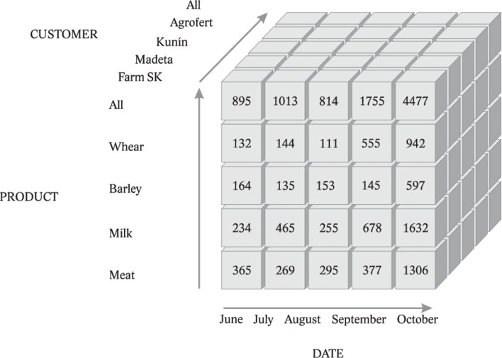
An Example
Introduction to DW/BI Systems

Slide 17
An Example
Imagine slicing and dicing along each of these dimensions.
Points inside the cube are where the measurements, such as sales volume or profit, for that combination of product, market, and time are stored.
Introduction to DW/BI Systems

Slide 18
Another Example
Consider a company that sells electronic products in different parts of the United States.
In particular, the company markets four
different printer products (mono laser, ink jet, photo, and portable) in five different states
(California, Washington, Colorado, Utah, and
Arizona).
In order to store daily sales data for each
product and each location in a relational
database, you need Table, which consists of
three columns (Product, Location, and Sales)
and 20 rows (four instances of Product times five instances of Location).

Slide 19
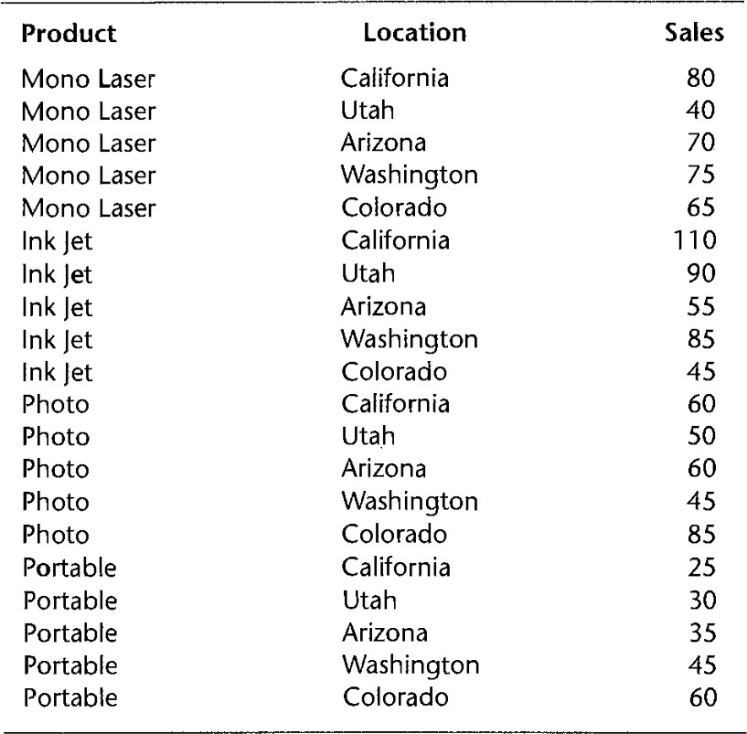
Relational Data

Slide 20
Problems with Relational Data
The representation of Table can be complex and unwieldy.
First, imagine that the company wishes to add a fifth product (say, color laser).
In order to track sales by states for this new product, you need to add five rows, one each for each state.
Second, note that the data in Table represents sales data for a particular day (for example, August 10, 2006).

Slide 21
Problems with Relational Data
In order to store the same data for all 365 days of 2006, you need to add a fourth column to store the sales date, and duplicate the 20 rows for each date 365 times to yield a total of 7,300 rows.
By the same token, if you wish to store historic data for a period of 10 years, you need 73,000 rows.
Each new row must contain the product, state, and date values.

Slide 22
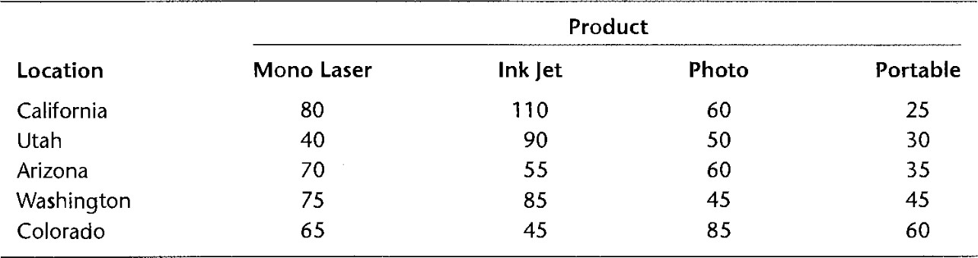
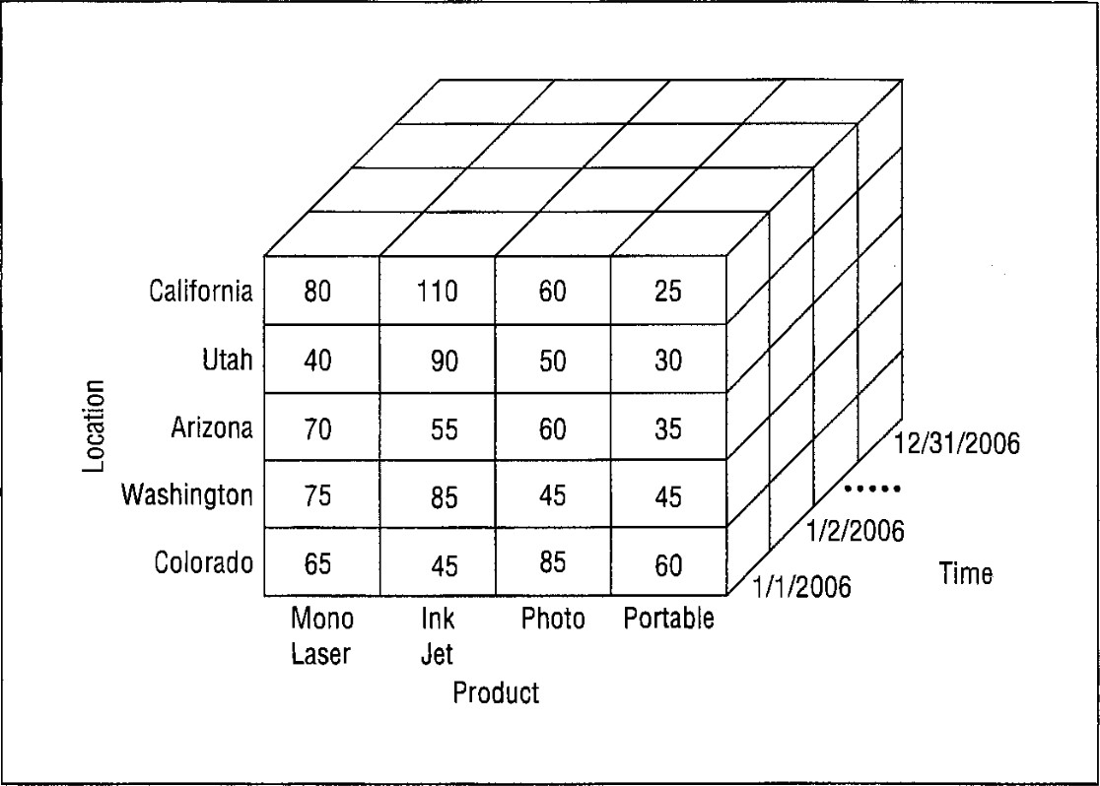
Solution: Multidimensional Data

Slide 23
Multidimensional Data Advantages
The multidimensional representation is simple to understand and extend.
For example, adding a fifth product category requires an additional column to the right of Table.
Adding dates requires a third dimension called Time, resulting in a three- dimensional arrangement.

Slide 24
Multidimensional Data Advantages
The multidimensional representation also provides a convenient representation of summary totals.
Each dimension in a cube can accommodate totals (row totals, column totals, depth totals, and overall totals) that a user can identify easily.

Slide 25
Multidimensional Data Advantages
In addition to advantages in usability, the multidimensional representation can provide increased retrieval speed.
Direct storage of multidimensional data obviates the need to convert from a table representation to a multidimensional representation.

Slide 26
Multidimensional Data Disadvantages
However, the multidimensional representation can suffer from excessive storage because many cells can remain empty.
Even with compression techniques, large multidimensional tables can consume considerably more storage space than corresponding relational tables.

Slide 27
Multidimensional Terminologies

Slide 28
Data Cube
A data cube or hypercube generalizes the two- dimensional and three- dimensional representations shown in the previous section.
A data cube consists of cells containing measures (numeric values such as the unit sales amounts) and dimensions to label or group numeric data (e.g., Product, Location, and Time).
Each dimension contains values known as members. For instance, the Location dimension has five members (California, Washington, Utah, Arizona, and Colorado).

Slide 29
Data Cube
Both dimensions and measures can be
stored or derived.
For example, purchase date is a stored dimension with purchase year, month, and day as derived dimensions.

Slide 30
Dimension Details
Dimensions can have hierarchies composed of levels.
For instance, the Location dimension may have a hierarchy composed of the levels country, state, and city.
Likewise, the Time dimension can have a hierarchy composed of year, quarter, month, and date.
Hierarchies can be used to drill down from higher levels of detail (e.g., country) to lower levels (e.g., state and city) and to roll up in the reverse direction.

Slide 31
Dimension Details
Although hierarchies are not essential, they allow a convenient and efficient representation.
Without hierarchies, the Location dimension must contain the most detailed level (city).
However, this representation can be difficult to compute aggregates across the dimension.
Alternatively, the Location dimension can be divided into separate dimensions for country, state, and city resulting in a larger data cube.

Slide 32
Multiple Hierarchies
For flexibility, dimensions can have multiple hierarchies.
In a dimension with multiple hierarchies, usually at least one level is shared.
For example, the Location dimension can have one hierarchy with the levels country, state, and city, and a second hierarchy with the levels country, state, and postal code.

Slide 33
Measure Details
Cells in a data cube contain measures such as the sales values.
Measures support numeric operations such as
simple arithmetic, statistical calculations, and simultaneous equations.
A cell may contain one or more measures.
For example, the number of units can be another measure for the sales data cube.
The number of nonempty cells in a
multidimensional cube should equal the
number of rows in the corresponding relational table.

Slide 34
Measure Details
Derived measures can be stored in a data cube or computed from other measures at run time.
Measures that can be derived from other measures in the same cell typically would not be stored.
For example, total dollar sales can be calculated as total unit sales times the unit price measures in a cell.
Summary measures derived from a collection of cells may be stored or computed depending on the number of cells and the cost of accessing the cells for the computation.

Slide 35
Data Cube Operations

Slide 36
Slice
Because a data cube can contain a large number of dimensions, users often need to focus on a subset of the dimensions to gain insights.
The slice operator retrieves a subset of a data cube similar to the restrict operator of relational algebra.
In a slice operation, one or more dimensions are set to specific values and the remaining data cube is displayed.

Slide 37
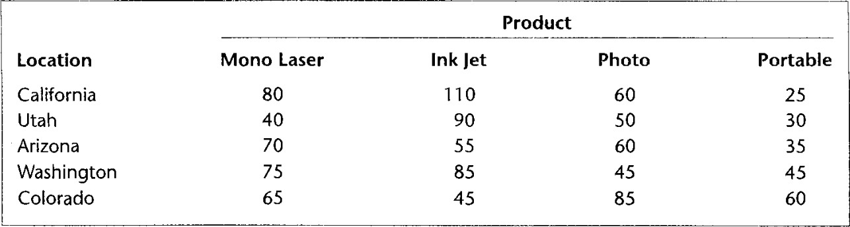
Slice
Figure shows the data cube resulting from the slice operation where Time = 1/1/2006 and the other two dimensions (Location and Product) are shown.

Slide 38
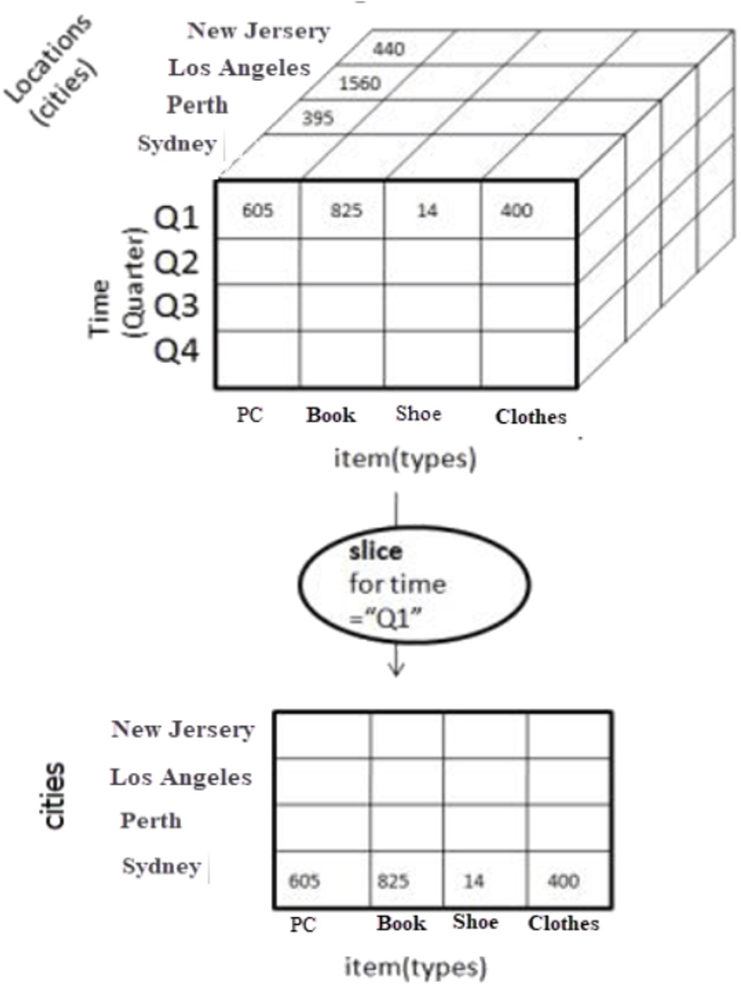
Slice

Slide 39
Slice-Summarize
A variation of the slice operator allows a decision maker to summarize across members rather than to focus on just one member.
The slice-summarize operator replaces one or more dimensions with summary calculations.
The summary calculation often indicates the total value across members or the central tendency of the dimension such as the average or median value.

Slide 40
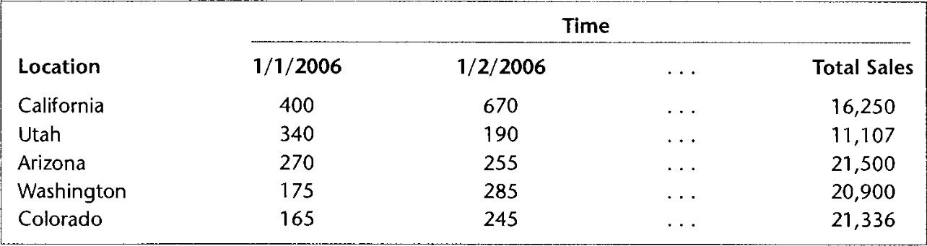
Slice-Summarize
For example, Figure shows the result of a slice-summarize operation where the Product dimension is replaced by the sum of sales across all products. A new column called Total Sales can be added to store overall product sales for the entire year.

Slide 41
Dice
Because individual dimensions can contain a large number of members, users need to focus on a subset of members to gain insights.
The dice operator replaces a dimension with a subset of values of the dimension.

Slide 42
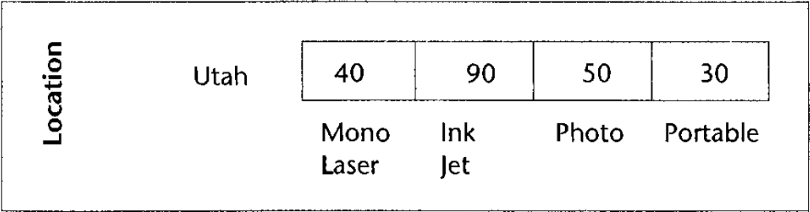
Dice
For example, Figure shows the result of a dicing operation to display sales for the State of Utah for January 1, 2006. Dicing typically follows a slicing operation and returns a subset of the values displayed in the preceding slice. It helps focus attention on one or more rows or columns of numbers from a slice.

Slide 43
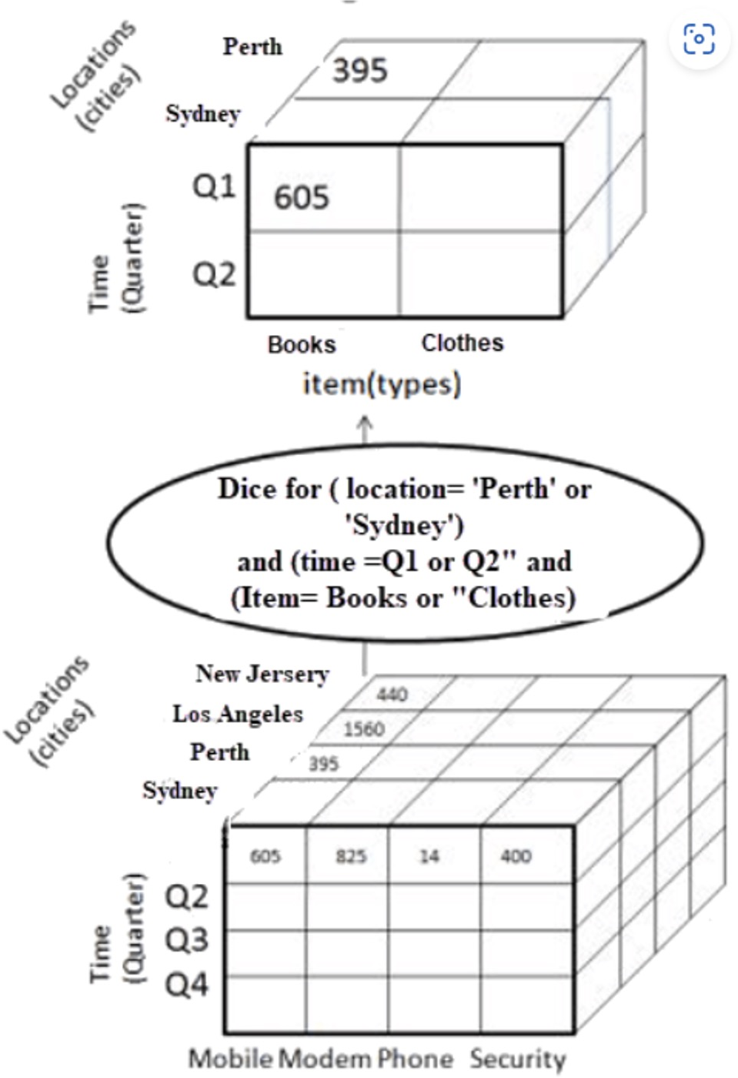
Dice

Slide 44
Drill-Down
Users often want to navigate among the levels of hierarchical dimensions.
The drill-down operator allows users to navigate from a more general level to a more specific level.

Slide 45
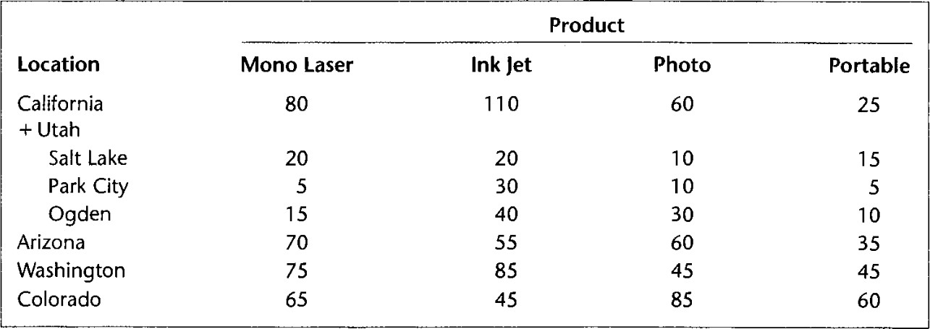
Drill-Down
Figure shows a drill-down operation on the State of Utah of the Location dimension. The plus sign by Utah indicates a drill-down operation.

Slide 46
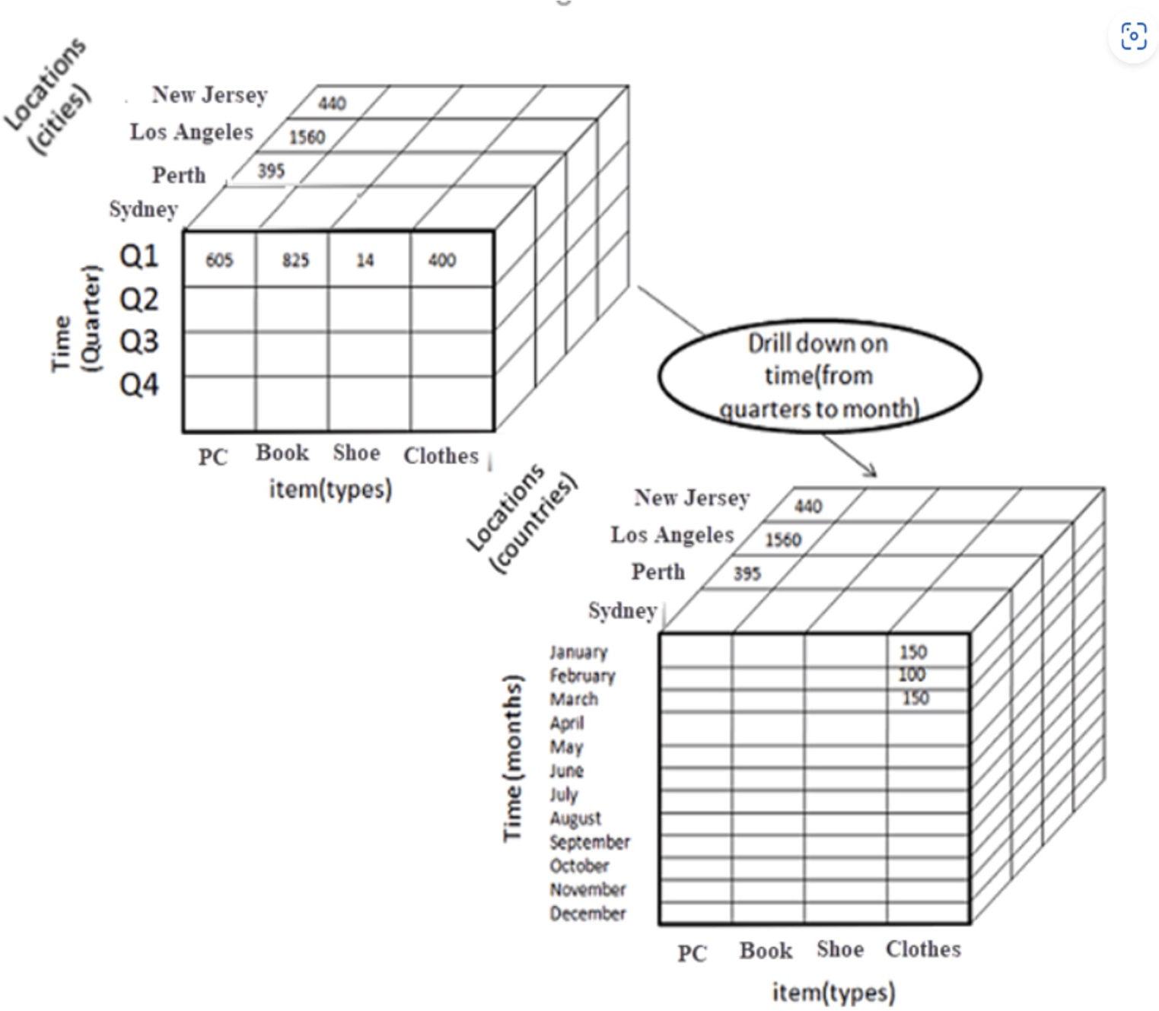
Drill-Down

Slide 47
Roll-Up
Roll-up (also called drill-up) is the opposite of drill-down.
Roll-up involves moving from a specific level to a more general level of a hierarchical dimension.
For example, a decision maker may roll up sales data from daily to quarterly level for end-of-quarter reporting needs.

Slide 48
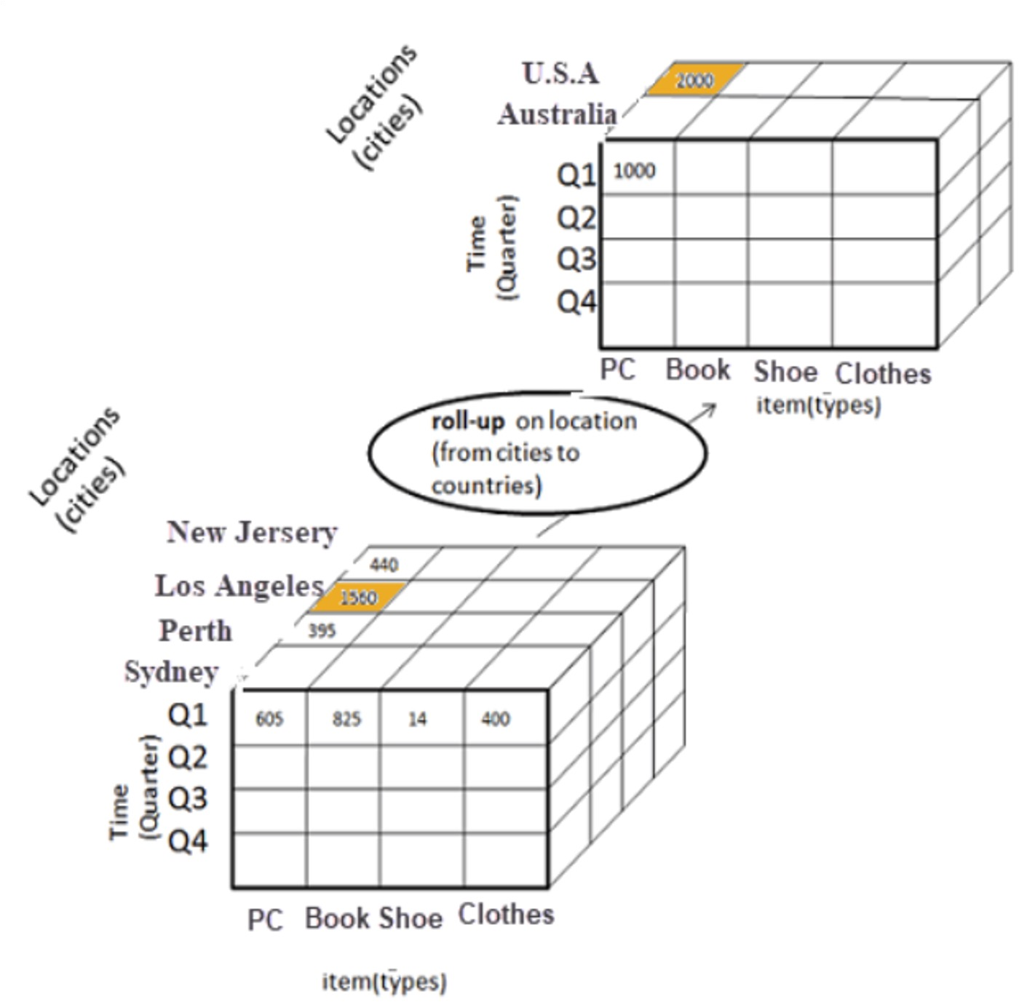
Roll-Up

Slide 49
Pivot
The pivot operator supports rearrangement of the dimensions in a data cube.
For example, the position of the Product and the Location dimensions can be reversed so that Product appears on the rows and Location on the columns.
The pivot operator allows a data cube to be presented in the most appealing visual order.

Slide 50
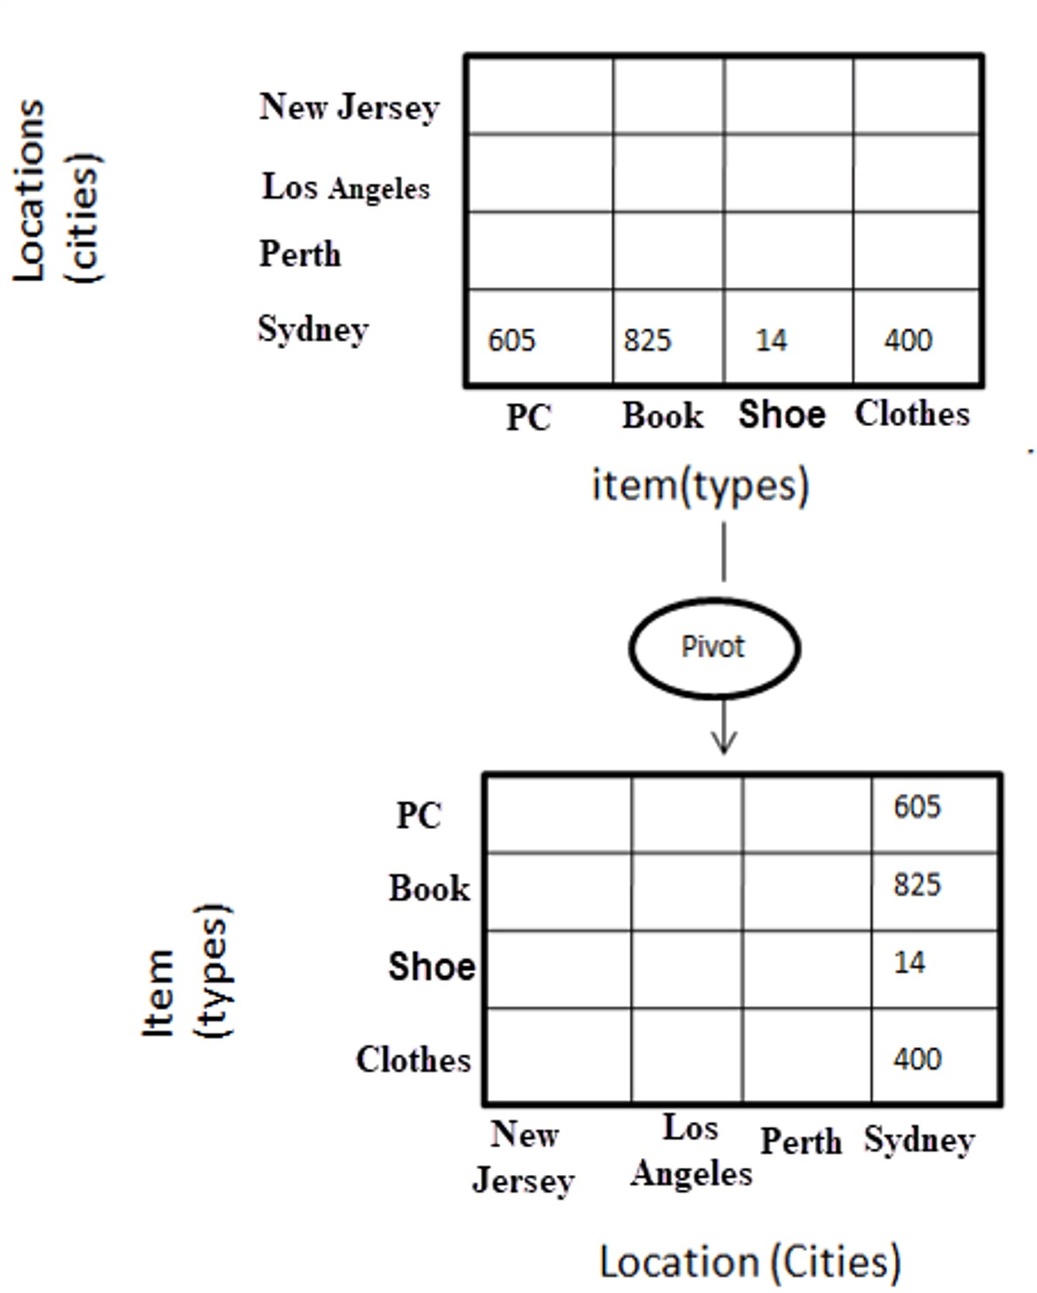
Pivot

Slide 51
Pivot
The pivot operator supports rearrangement of the dimensions in a data cube.
For example, the position of the Product and the Location dimensions can be reversed so that Product appears on the rows and Location on the columns.
The pivot operator allows a data cube to be presented in the most appealing visual order.

Slide 52
Question

Slide 53
Questions
What are the advantages of multidimensional
representation over relational representation for business analysts?
Explain why a dimension may have multiple hierarchies.
What are the advantages of using time-series data in a cell instead of time as a dimension?
How is slicing a data cube different from dicing?
What are the differences between drilling-down and rolling-up a data cube dimension?
How is a pivot operation useful for multidimensional databases?

